Slide 1

Black Mesa

Slide 2
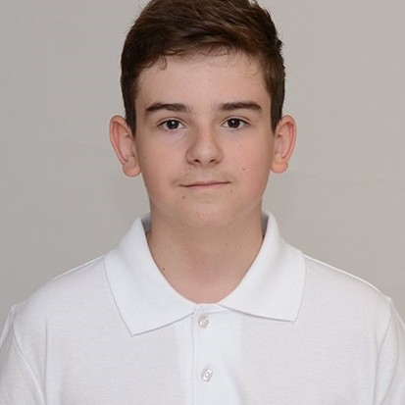
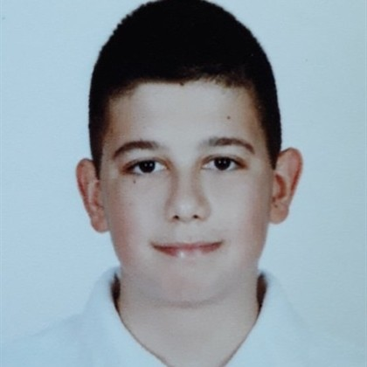
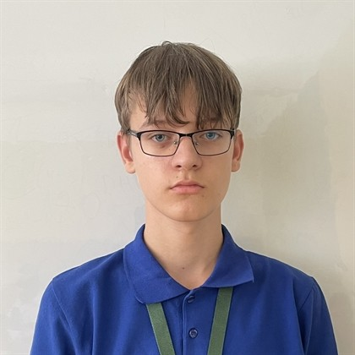

Team Members

Slide 3
The Process
Have a Meeting
Think for an Idea
01
02
Write The Code
03
Present
04

Slide 4
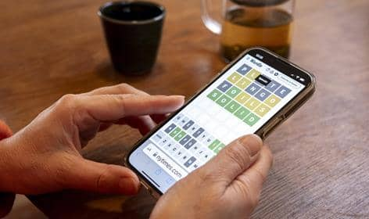
Our Idea And Why We Chose It

Slide 5

Problems When Coding

Slide 6



Used technologies​

